Slide 1

Breast Cancer Tumor Classifications

Slide 2

The problem:
1 in 8 women will develop breast cancer in their lifetime.
Without ML the accuracy of breast cancer detection based on tumor features is around 85%.

Slide 3

The Solution:
Using ML, we can improve the accuracy of breast cancer detection to over 95%.
We can reduce the false negatives to less than 5%.
We can reduce the false positives to less than 5%

Slide 4
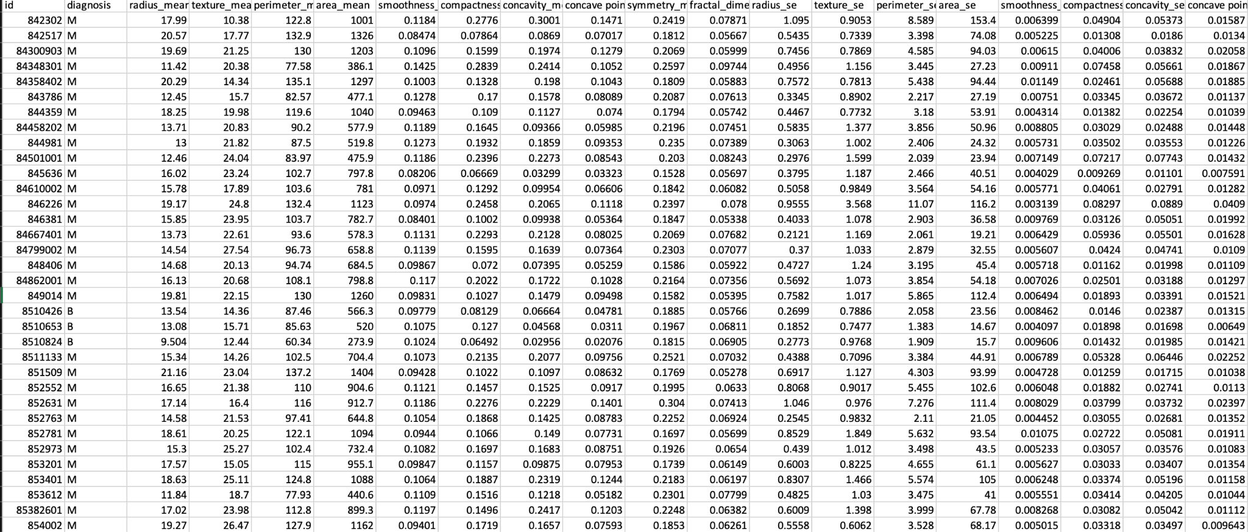
The Data:
Data Source: https://www.kaggle.com/datasets/uciml/breast-cancer-wisconsin-data

Slide 5
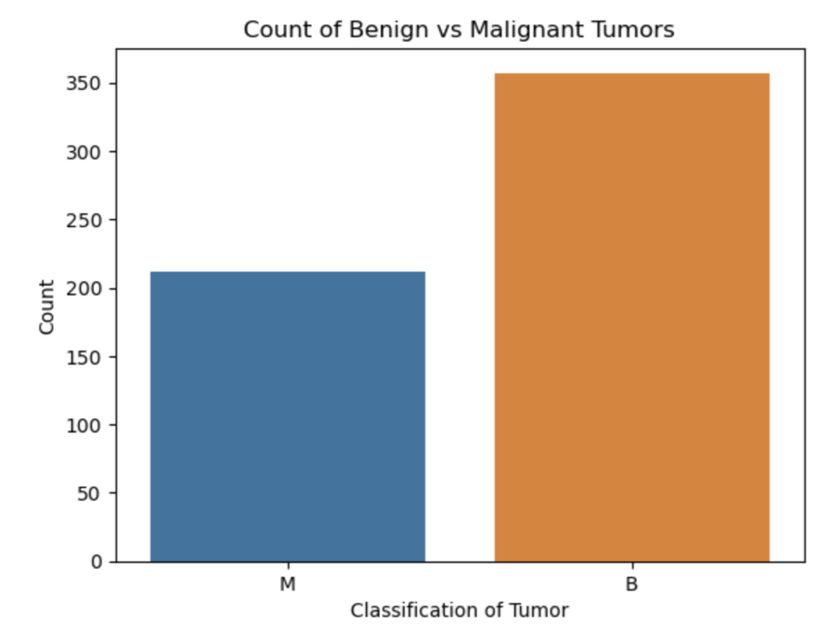
Data Wrangling:
Dataset had 32 columns with 569 samples
Two columns were not “useful” - “id” and “Unnamed: 32”
Removed them leaving 30 features
Malignant tumors is the minority class

Slide 6
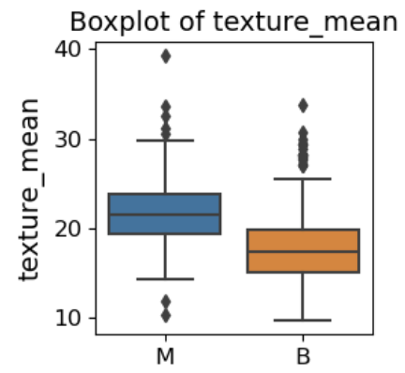
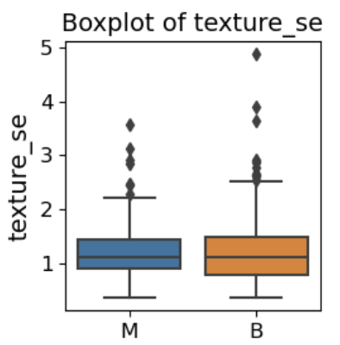
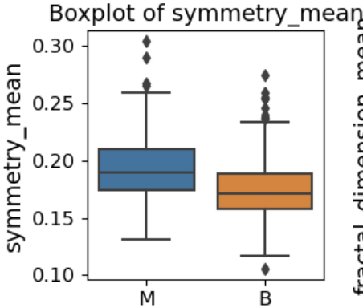
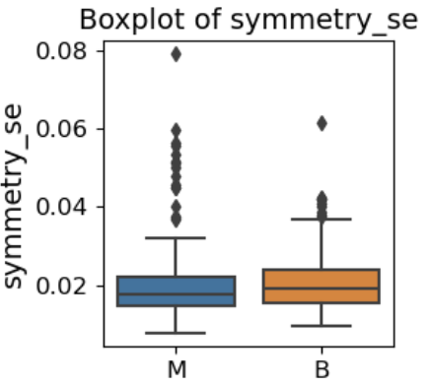
EDA
Notes:
The standard error (SE) metrics, marked by _se, show significant outliers in both benign and malignant tumors. This is expected, as both tumor types have a wide range of values across features, which can cause outliers in the SE calculations.

Slide 7
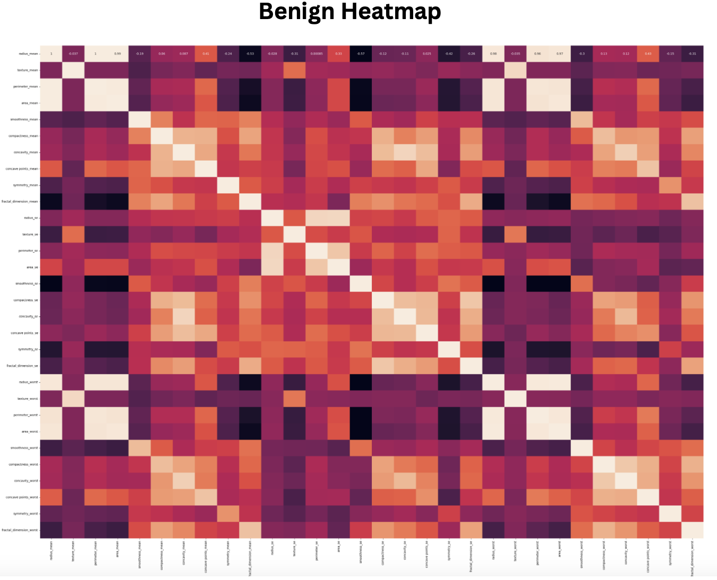
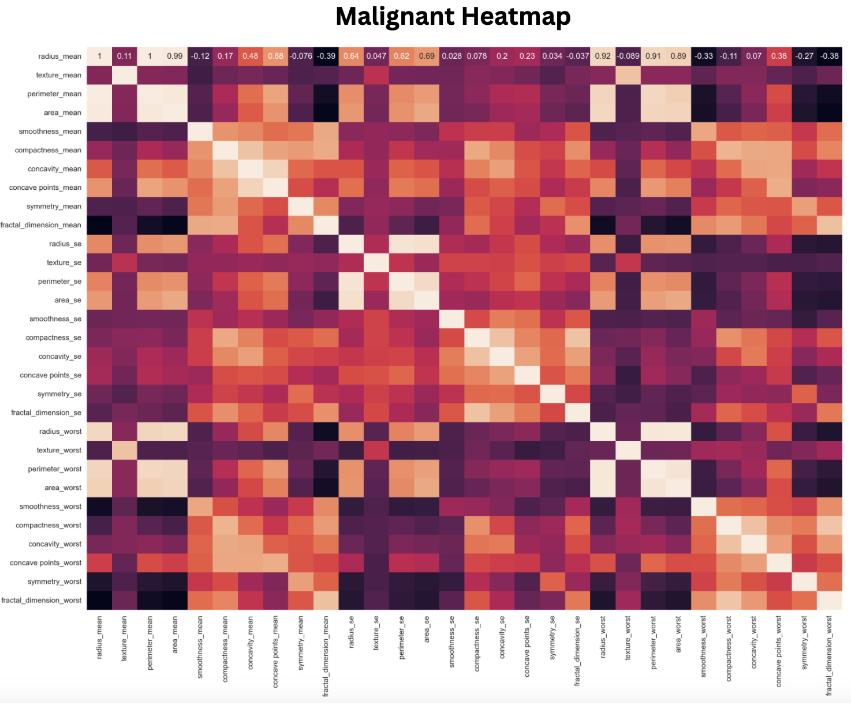
Heatmaps of Benign vs Malignant Tumors
Notes:
The standard error (SE) metrics, marked by _se, show significant outliers in both benign and malignant tumors. This is expected, as both tumor types have a wide range of values across features, which can cause outliers in the SE calculations.

Slide 8
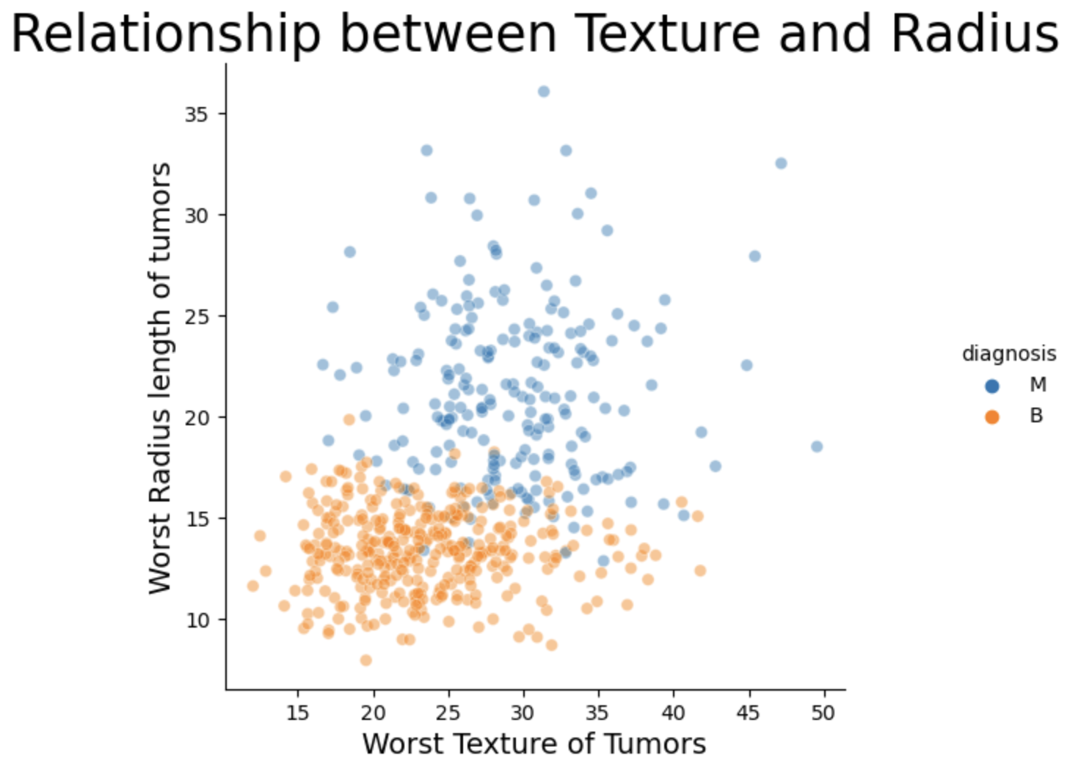
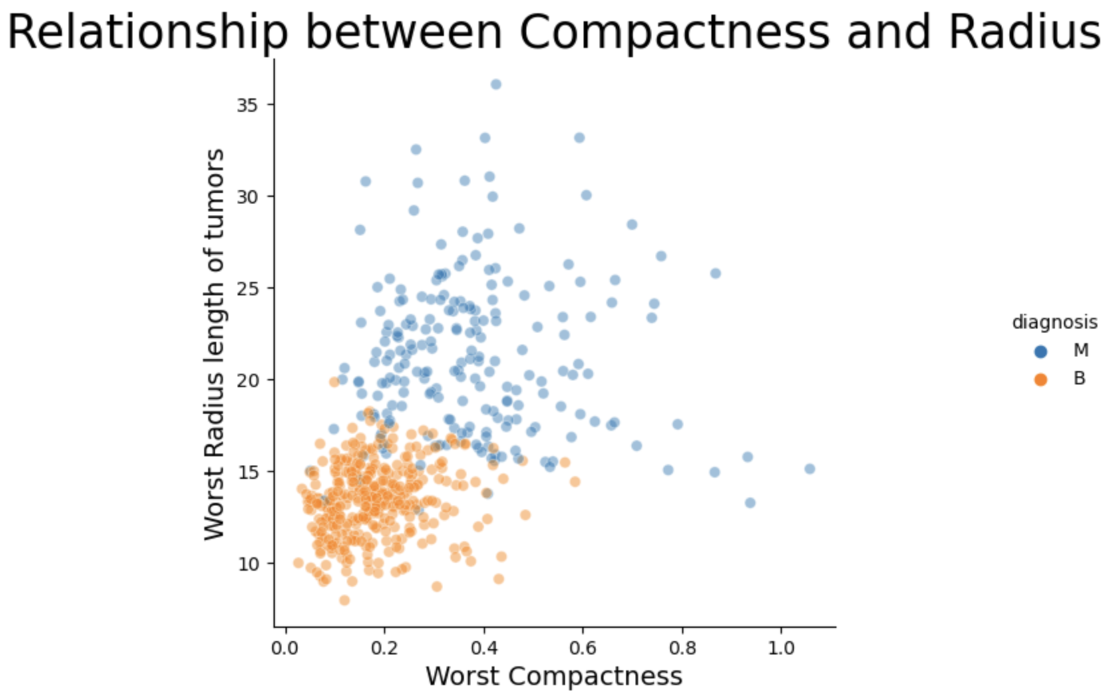
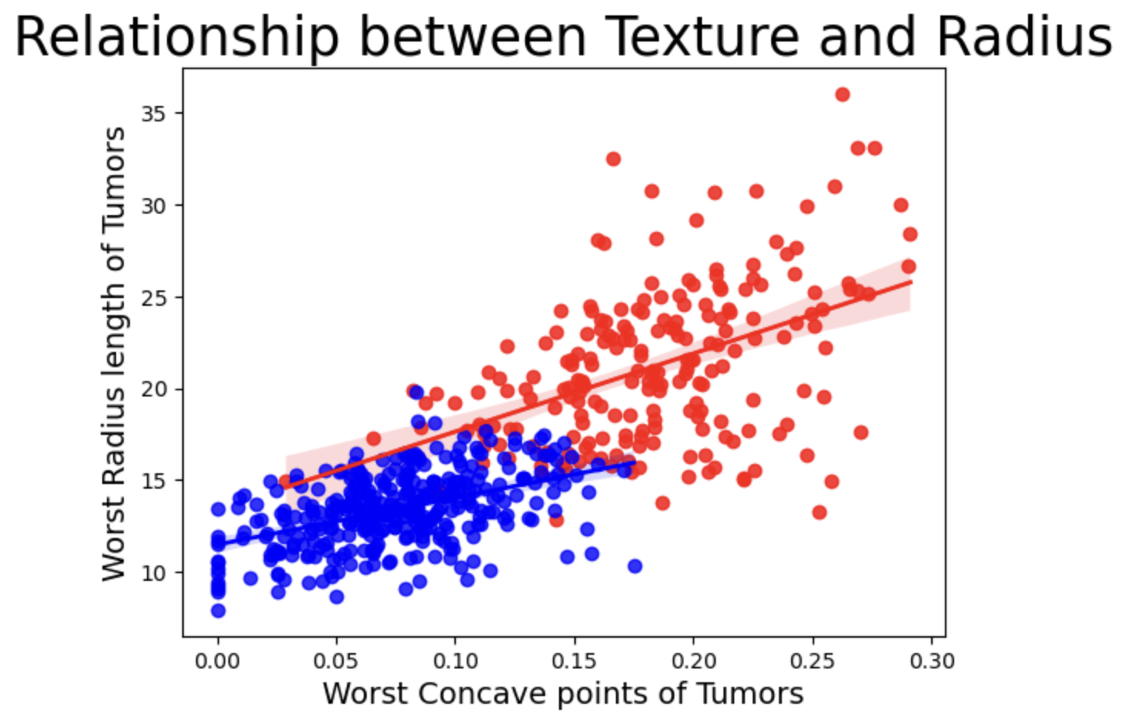
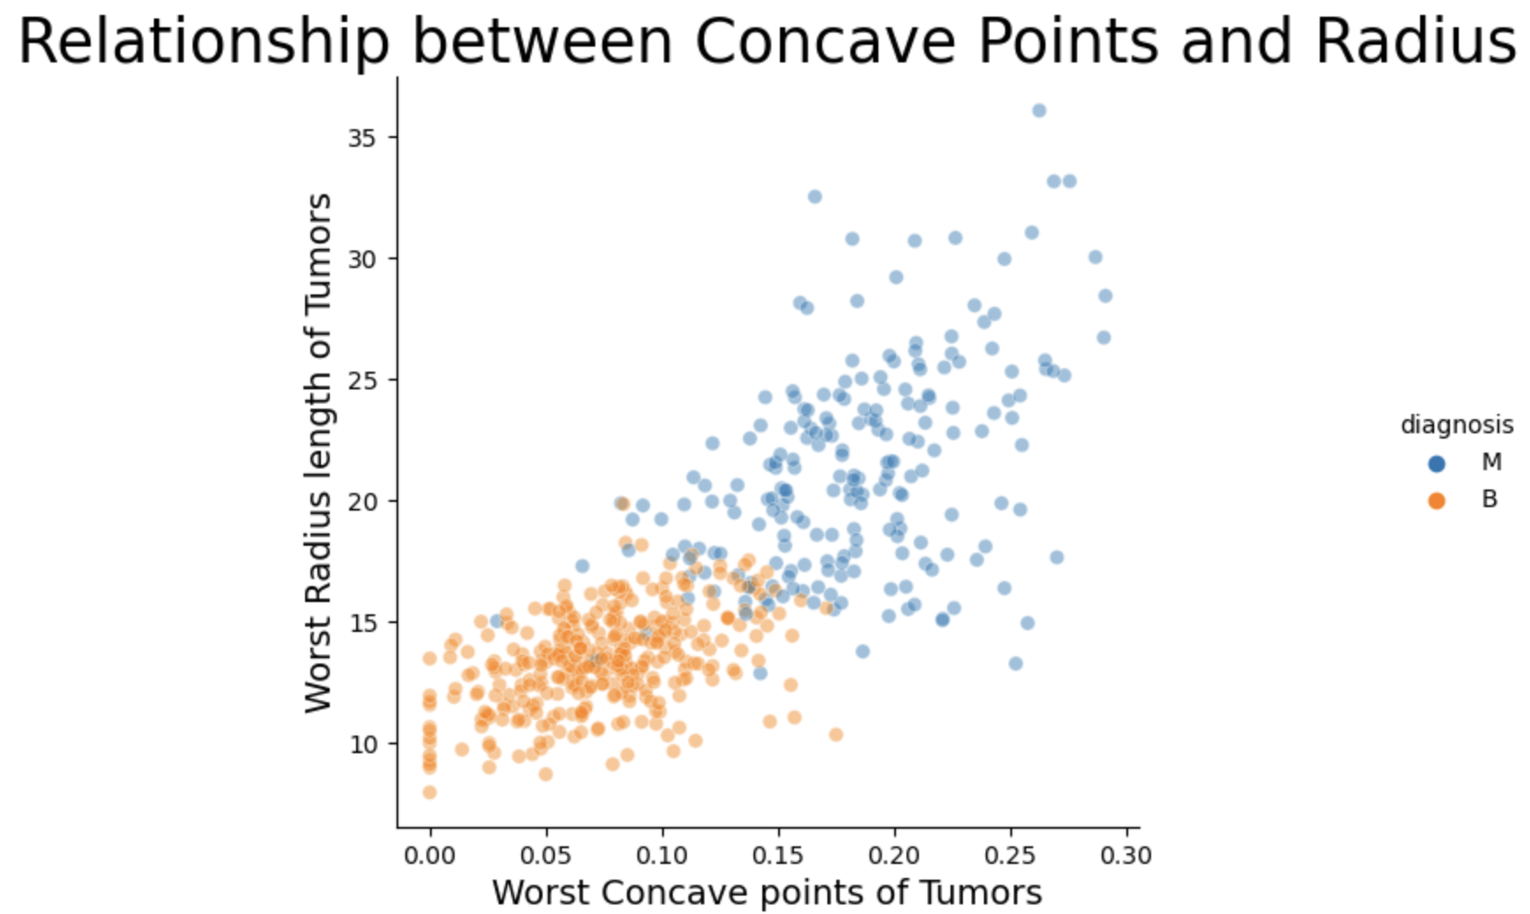

Slide 9
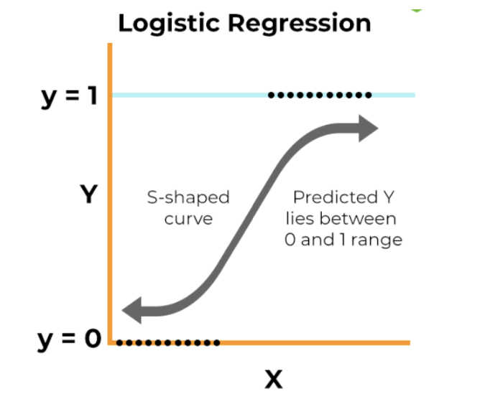
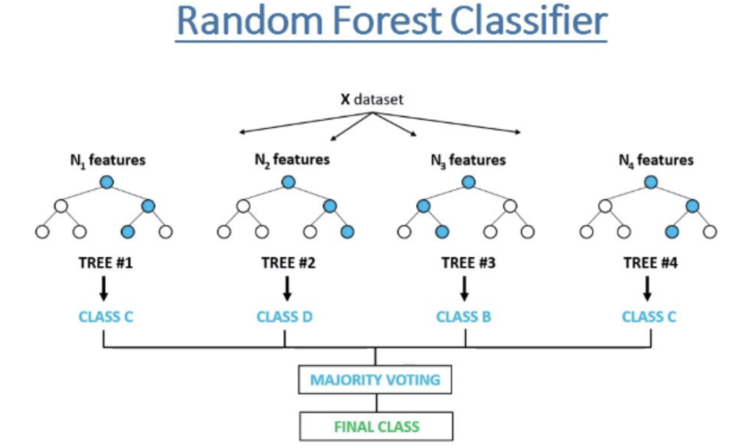
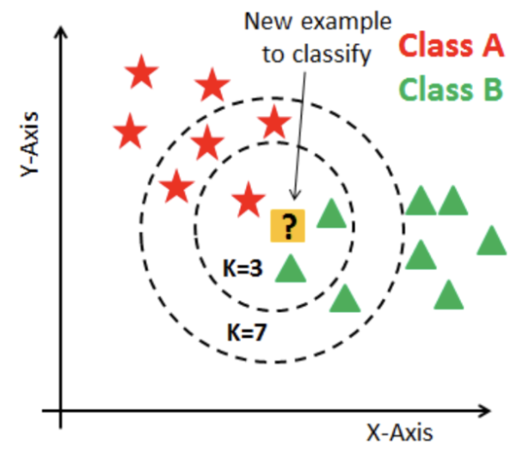
Model Selection
Logistic Regression
2. Random Forest Classifier
3. K Nearest Neighbors

Slide 10
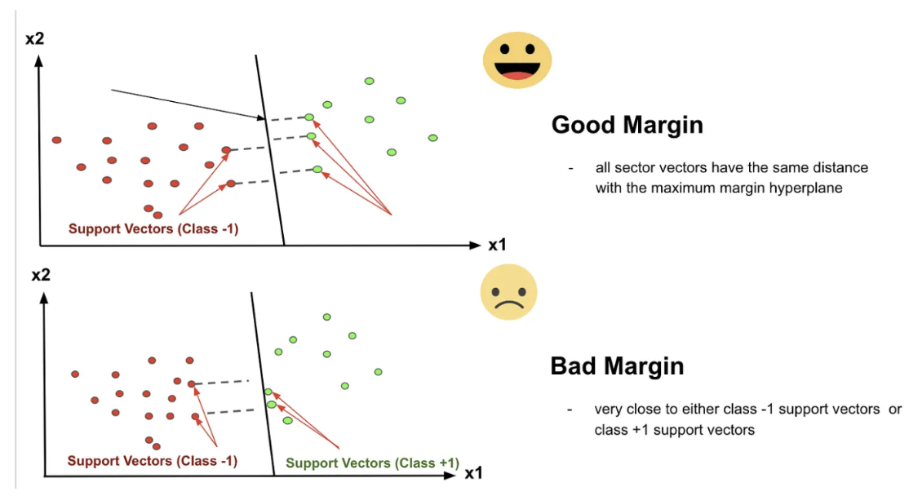
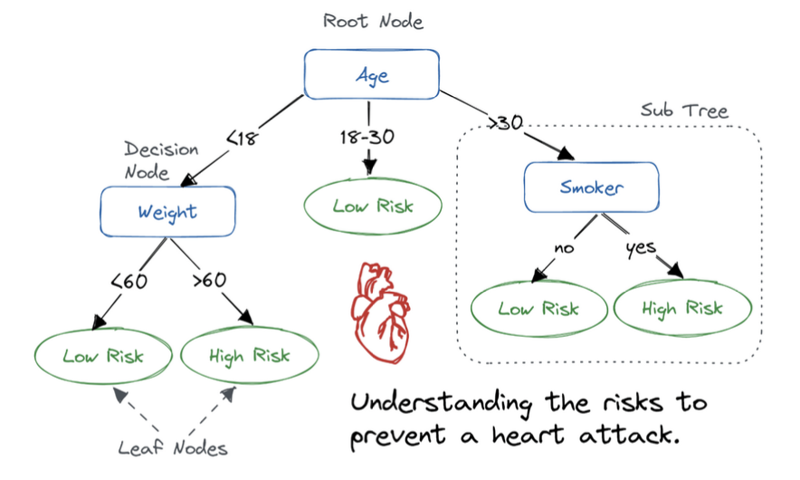
4. Support Vector Classifier
5. Decision Tree Classifier

Slide 11
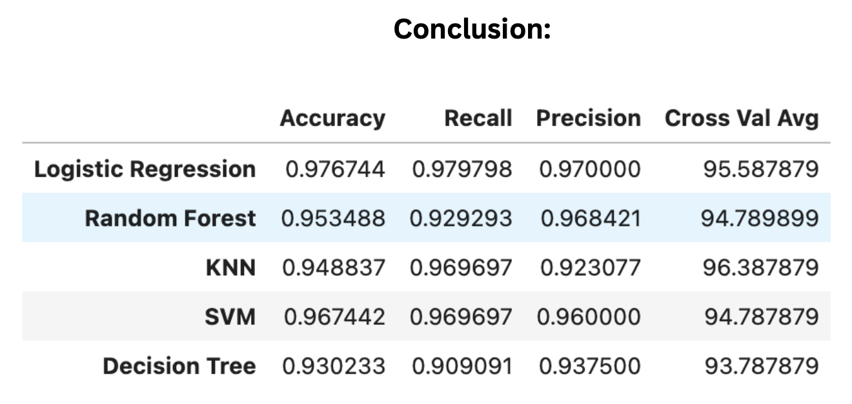
Model Results after hyper-parameter adjustments
Notes:
Used GridSearchCV and RandomizedSearchCV to find the best parameters for each model.

Slide 12
Takeaways:
Logistic regression has an accuracy of 97.67% for correct classification
Logistic regression has less than 2.02% false negatives
Logistic regression has 3% false positives, which would just lead to more testing
Cross Validation score is 95.58%

Slide 13
Questions?

